Slide 1
Azure Active Directory for Developers

Slide 3
Agenda
Goal
AAD and Azure services
Application registration
Identities (users, service principals)
Access control
Programmatic access (Graph, PowerShell)

Slide 4
Goal
Minimize cost, maximize control of access
At most one challenge (SSO)
Do not force users to use multiple identities (federation)
Use better credentials than passwords (device possession, biometrics)
Make the protection from break-in proportional to value of accessed asset (conditional access)
Notes:
Explain that while new apps may be developed to use modern protocols, an enterprise may need to support 3rd party and own legacy applications which use other ways of user authentication. AAD supports both modern protocols but also has features to provide SSO to the other apps.

Slide 5
AAD sign-in features
Application access control | AAD features
Claims aware/modern protocol support | Modern protocol support
Application-specific user credentials | Password vaulting
Proxy-injected auth header | AAD Proxy
Kerberos | AAD Proxy
Kerberos, other (migrated to Azure PaaS) | EasyAuth
Notes:
Header based: CA Siteminder, Oracle AM, IBM IAM, OpenSSO; today often done with Ping Federate?
500 trans/app proxy
750 trans/AAD instance

Slide 6
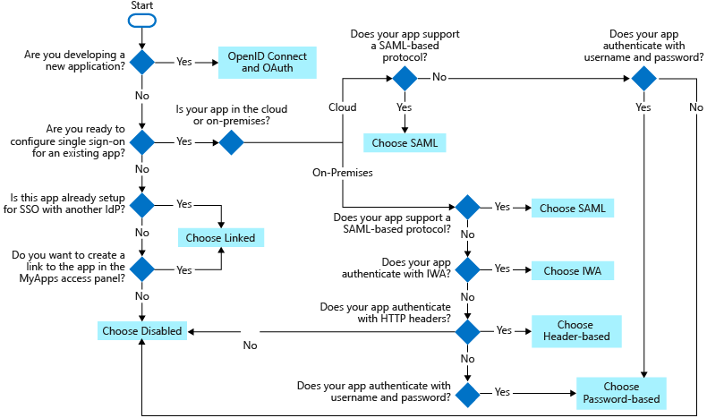
Applications and SSO
Our focus
Notes:
https://docs.microsoft.com/en-us/azure/active-directory/manage-apps/what-is-single-sign-on

Slide 7
Focus of this module
Internet resource access
Using OIDC/OAuth2 protocols
Enterprise users
Un-attended services
Not covered:
SAML/WSFed
AAD Proxy
Setup/operations
Consumer users (B2C)

Slide 8
Azure Active Directory for Developers
Tenants

Slide 9
In this lesson you will learn about:
the concept of tenants in Azure AD
relationship between AAD tenants and Azure subscriptions
how to create a new Azure AD Tenant
how to add custom domains to the Azure AD Tenant

Slide 10
Tenant/directory
AAD is a SaaS, multi-tenant, cloud service
Use scoped to a tenant (~= trusted forest) == directory
A tenant may contain users from several domains
A domain may only exist in one tenant
A tenant may reference users from other directories (B2B)
Always identified with:
xyz.onmicrosoft.com
a GUID
custom domain name(s)
Notes:
Use example of an apartment block, individual tenants

Slide 11
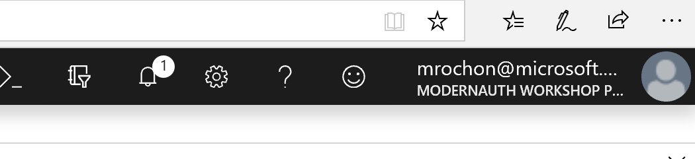
Azure AD and Azure cloud
AAD
Tenant 1
AAD
Tenant 2
Free-standing tenant created in an existing Azure subscription
Available to user(s) in (another) tenant
Create…
Access controlled by…
Azure Subscription
Azure Subscription
Select access through a different tenant (signin must be member/guest)
Azure portal view through this AAD tenant
Notes:
Discussion point: Which Azure subscription can you control through an Azure AD tenant created in a subscription? None, that tenant is just a service in a subscription, it controls no subscriptions

Slide 12
Creating an Azure Active Directory Tenant

Slide 13
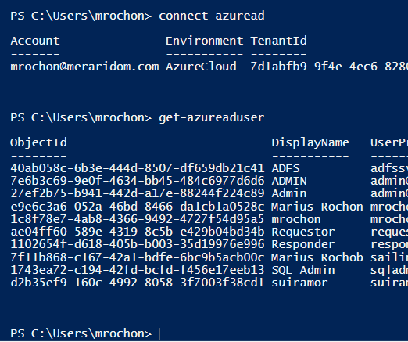
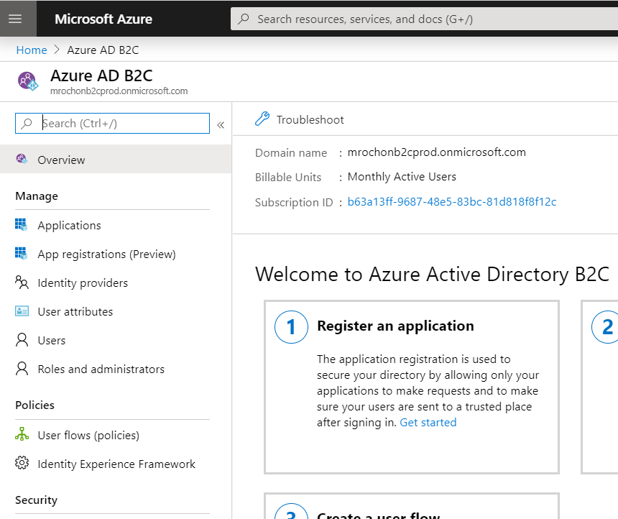
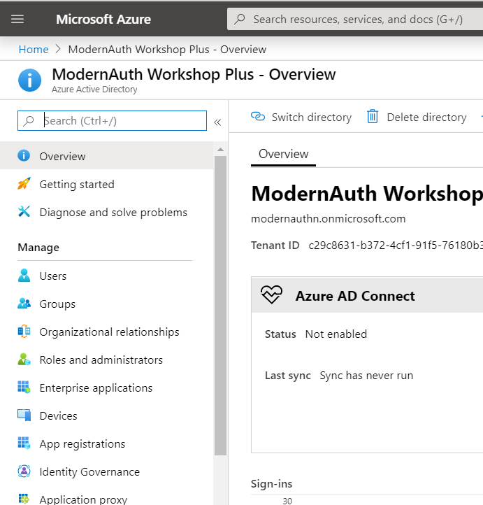
Accessing Azure AD
Portal B2C Blade
PowerShell AAD Module
AAD
Microsoft Graph (REST)
.NET SDK
https://graph.microsoft.com/v1.0/users?$filter=startsWith(displayName, 'M')
Portal AAD Blade

Slide 14
Azure Active Directory for Developers
Application registration

Slide 15
Agenda
Understand registration process
Parameters and their significance

Slide 16
AAD and applications
Configure token issuance (App Registration)
Configure what’s needed
Application id/secrets (confidential clients only)
Reply urls (for redirect-based authentication)
Define exposed and (optionally) required scopes
Implicit flow enablement
User roles
Visibility from other tenants
Operates on the Application entity
Registration creates both Application and Service Principal entities
Token issuance authorization (Enterprise Apps)
Configure what’s allowed
Who can access the application
Which scopes can be issued
Operates on Service Principal entities
…
Notes:
At this stage the application can only identify itself to AAD, it cannot yet get any services – that requires somebody’s consent!

Slide 17
App registration
Simple web app
Show Enterprise tab as well
Notes:
Leave definition of multi-tenant, etc. till later

Slide 18
OAuth2 scopes
Required
scopes
Exposed scopes
Application
(client)
Application
(resource)
Application roles
Obtained via OAuth2 Client Credentials flow
All required scopes require consent
Some may require admin consent
User scopes
Obtained via OAuth2 flow requiring user signin
Notes:
Questions:
Which OAuth2 flow will you use to get a token to access a function requiring Application permissions? (Client Credentials)
Same for User Permissions? Auth Code, OBO, Implicit, Resource Owner or Device Flow
App scopes are registered via Roles, User scopes via Exposed APIs

Slide 19
Application Registration Tools
Azure AD portal
Manifest file
Visual Studio - Change authentication wizard
PowerShell/GraphAPI

Slide 20
Roles and scopes
Roles
Apply to users or applications
What can the caller do on its own right
Admin assignment for users
Registration requests for applications
Requested with /.default scope
Scopes
Apply to users only
Permissions consented by resource owner
Registered or requested at runtime

Slide 21
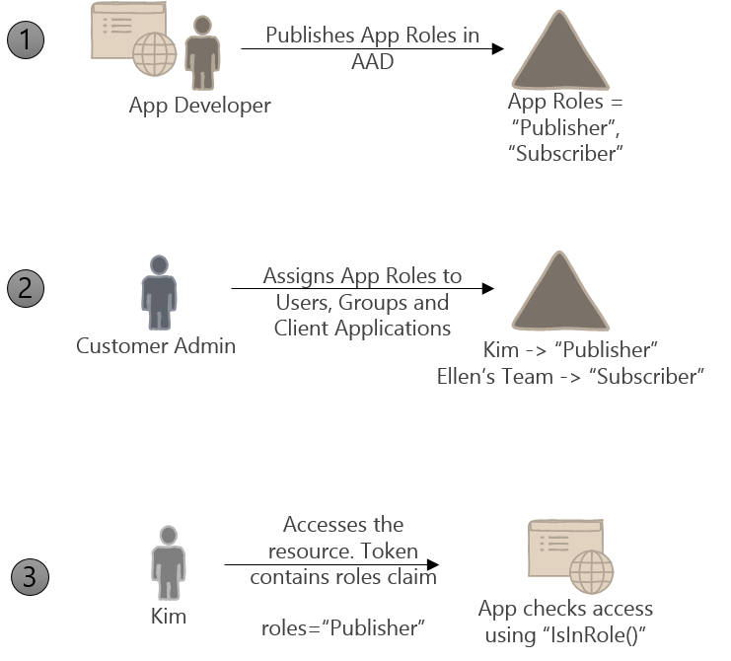
Role-Based Access Control (RBAC)
Defined in application manifest:
"appRoles": [
{
"allowedMemberTypes": ["User"],
"description": "Admins can manage roles and perform all task actions.",
"displayName": "Admin",
"id": "81e10148-16a8-432a-b86d-ef620c3e48ef",
"isEnabled": true,
"origin": "Application",
"value": "Admin"
},
Through Azure portal, Powershell or GraphAPI
Application code
Notes:
Applications often need more information about the user to decide which parts of the application (functionality) a particular user has access to or not. One way to do this is by using additional claims included in the security tokens, e.g. group membership. Role-based authorization allows the application to declare apriori what are the different levels of access it supports. System admin can then assign users and groups to these roles. Role information will then be included in the token and can be used by application code either in IsInRole API ro AuthorizeAttribute(Roles=‘…).
See http://www.dushyantgill.com/blog/2014/12/10/roles-based-access-control-in-cloud-applications-using-azure-ad/
Show application manifest and portal UI for assigning users/groups to application roles

Slide 22
Enterprise Apps
Controlling user access
Add roles
Show admin consent

Slide 23
Multi-tenant app
Show app registration options

Slide 24
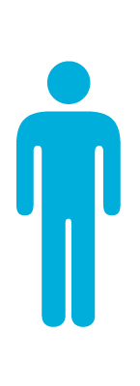
Multi-tenant application
Home tenant
Another tenant
App
SP
SP
2. Consent
1. Register
Multi-tenant app
3. Token

Slide 25
Multi-tenant application
Application defined in one tenant & marked as multi-tenant
AAD creates SP in other tenants on consent
Allows each tenant to control their access to the tenant
Application decides which tokens (issuer) to accept
Requires some application logic adaptation

Slide 26
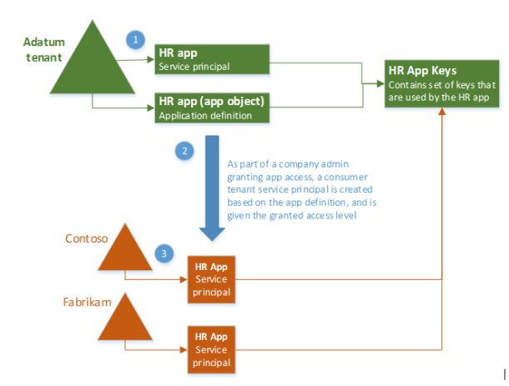
Applications and Service Principals

Slide 27
Multi-tenancy and consent
By default, any user can initiate mt signup
A tenant may require all mt apps consented by admins first
An application may need admin consent due to permissions it needs
Application must provide logic to request admin consent if needed

Slide 28
Azure Active Directory for Developers
Identities

Slide 29
Agenda
Users
Service principals
Managed Identities

Slide 30
Show Users tab in AAD with various user types

Slide 31
User types
How created?
Managed – created directly in the AAD tenant
Synced – sync’ed via AAD Connect from on-premises – attributes may not be edited
External – invited via B2B
Status in tenants
Members
Can enumerate other users
Default for managed and sync’ed
Guest
Cannot enumerate (may not have other default AAD privileges, e.g. app create)
Default for External

Slide 32
Groups
Static
Users
Other groups
Dynamic
Based on user attributes
Based on device attributes

Slide 33
Access control
Unconditional
Default
Any user can sign in
Assigned
By user or group
May include Role
Conditional
Group membership
Location (network trust level)
User platform
Device registration
User risk level

Slide 34
B2B – External Identities - Purpose
Manage authorization to our resources by users external to our directory
Allow external users to continue using their current credentials
Automatically remove access if external user no longer employed by partner
Notes:
Example: access to our Sharepoint documents by partners we are collaborating with

Slide 35

Inviting users- simplified
Tenant 1
Resource
Tenant
Tenant 2
Home
Tenant
3. Access redemption link or exposed resource, consent
Invites, allocates privileges and roles
User
2. Invitation email (optional)
Inviter
User
Notes:
https://cloudblogs.microsoft.com/enterprisemobility/2018/05/14/exciting-improvements-to-the-b2b-collaboration-experience/

Slide 36
Business-to-Business (B2B) Users
Invitees must have an email address
Usually invited by email with an app/portal URL
Invitee must consent to inviters privacy and use policies
Email sent by Azure Active Directory or custom SMTP (using Graph API or PowerShell)
Home tenant – one of the following:
MSA if user invited via MSA email
Gmail if user invited via gmail email (requires federation setup with Gmail)
Existing guest user’s AAD tenant (could be viral)
Non-AAD federated tenant (direct federation)
New viral (un-managed) home tenant (silently created) or none (OTP option)
Resource tenant may enforce home tenant white-listing
User’s life-cycle managed in user’s home tenant (un-managed for viral tenant)
Authorization controlled in resource tenant
Invited user can leave resource tenant through their Azure identity settings

Slide 37
Multi-tenancy and B2B
 | Multi-tenant application | Application accessed through B2B
Purpose | Access control for SaaS | Access control to your resources
Application registration | Must be marked as multi-tenant App id must include home domain May not be un-registered till mt flag=No | Marked as single tenant
When visible to users? | User’s tenant consents to app access | User must be invited to app tenant
Access control | Managed by user’s tenant (not where app is registered) | Managed by inviting tenant
Application logic | Uses /common endpoint for HRD Allows tokens from variable list of issuers (tenants) Uses issuer | Handles all users irrespective of their upn domain
Note that a multi-tenant app may also be accessed by B2B users in each tenant which subscribed (consented) to the app, e.g. that’s how SPO is often used
Notes:
Note that O365 uses user domain and additional AAD attributes to manage mailboxes – contrary to the last item above. Therefore, you cannot use B2B to let people external guests have mailboxes in your own O365

Slide 38
Enterprise apps
Created by app own registration
3rd party
Go over control features

Slide 39
Service principal
A non-user identity
Usually represents an application (registered in this or another tenant)
Used to control access by users and other applications

Slide 40
Managed Identity
Manages credentials for service principals (applications, services)
AAD injects secrets into Azure service at deployment time
Reduces risks of credential leak
Examples of services supporting it:
Azure App Services
VM scale sets
Functions
Data Factory
Container Registry
…

Slide 41
Using Managed Identity
How is callee authorized? | Operation | Examples
Azure RBAC | Client uses a special, private endpoint to obtain service-specific access tokens | SQL, EventHub, KeyVault
Other AAD access token | Standard AAD token request BUT permission assignment not accessible through the Azure portal - requires use of API (e.g. PowerShell setup) | Graph, Custom APIs
Properietary | Client uses a special, private endpoint to obtain an authentication token. Resource uses token’s clientId to manage authorization. | CosmosDB (with custom Token Broker)
Notes:
https://stackoverflow.com/questions/48013011/msi-permissions-for-graph-api/48014153#48014153

Slide 42
Azure Active Directory for Developers
Programmatic access

Slide 43
After completing this lesson, you will:
Gain familiarity with API (Graph) and script language (PowerShell) access to AAD data

Slide 44
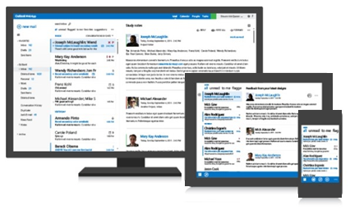
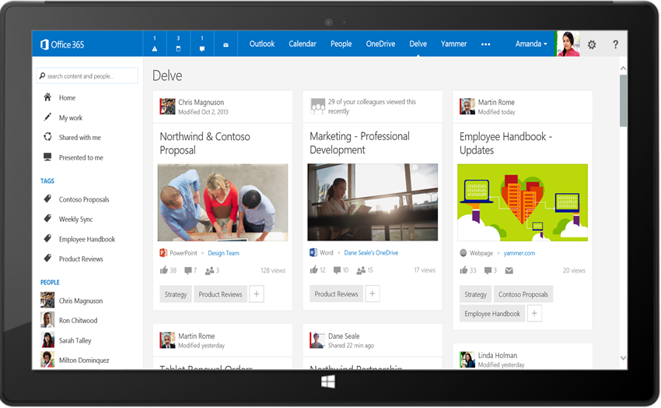
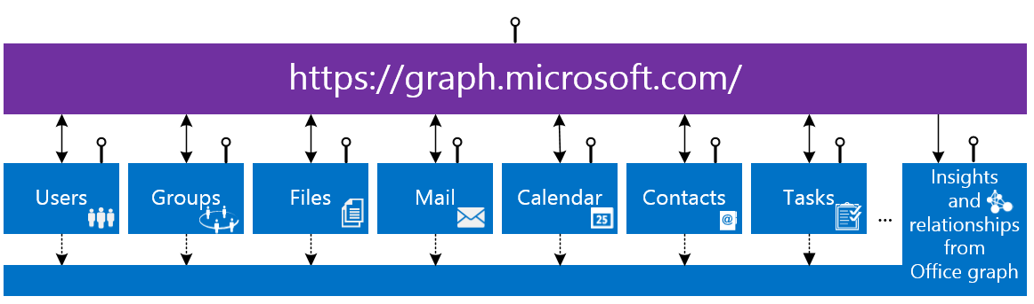
Microsoft Graph API
Microsoft Graph:
Clean API CRUD for developers, providing access to digital work and life data
YOUR
APP
https://graph.microsoft.com/
Notes:
https://developer.microsoft.com/en-us/graph/docs/concepts/permissions_reference

Slide 45
General
REST API with some OData extensions
OAuth2 security
Supports CRUD on many cloud entities incl. Azure AD
Support for open and schema extensions
Special functions:
revokeSignInSessions (revoke refresh tokens, etc.)
Threat assessments
Notes:
https://graph.microsoft.com/beta/users?$filter=identities/any(id:id/issuer eq 'mrochonb2cprod.onmicrosoft.com' and id/issuerAssignedId eq 'mrochon@mrochonb2cprod.onmicrosoft.com')

Slide 46
Audit trails
Use MS Graph
https://graph.microsoft.com/beta/auditLogs/directoryAudits
https://graph.microsoft.com/beta/auditLogs/signIns
Documentation
Show in MS Graph Explorer
Notes:
https://docs.microsoft.com/en-us/azure/active-directory/reports-monitoring/concept-reporting-api

Slide 47
MS Graph Explorer
https://developer.microsoft.com/graph/graph-explorer

Slide 48
Azure Active Directory for Developers
PowerShell

Slide 49
PowerShell
AzureAD module
Based on Graph API
Commonly used for devops-type application registration and deployment
Note that Graph API can also be used directly from PS

Slide 50
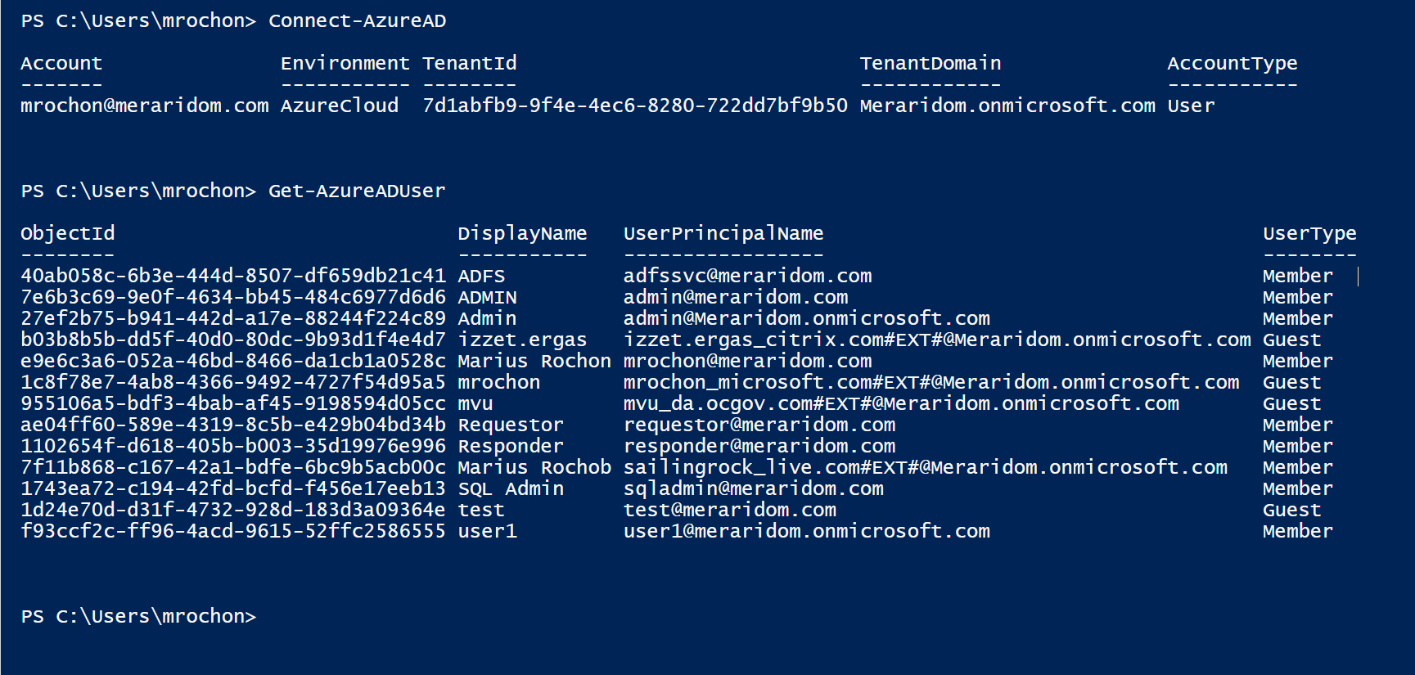
Sign-In
Notes:
More complex: Get-AzureADUser| Where-Object {$_.UserPrincipalName -like '*#EXT#*'}

Slide 51
Graph and PowerShell

